Slide 1
DH 1: Sprache und Text Korpusindexierung und -abfragen
Andreas Blombach, Stephanie Evert Lehrstuhl für Korpus- und Computerlinguistik
https://www.linguistik.phil.fau.de

Slide 2
Repräsentationsformate & Indexierung

Slide 3
Korpusannotation: Rohtext + Metadaten
It seemed a day much as any other until I happened to look out of the back window. There was a little garden behind the house; a well-mown lawn surrounded by a neatly cut hedge, a few bushes and colourful flowers.
Metadaten
title: The Garden
author: Stefan Evert
author sex: male date: 05.08.1991

Slide 4
Korpusannotation: Tokenisierung
It seemed a day much as any other until I happened to look out of the back window . There was a little garden behind the house ; a well-mown lawn surrounded by a neatly cut hedge , a few bushes and colourful flowers .

Slide 5
Korpusannotation: Satzsegmentierung
<s> It seemed a day much as any other until I happened to look out of the back window . </s>
<s> There was a little garden behind the house ; a well-mown lawn surrounded by a neatly cut hedge , a few bushes and colourful flowers . </s>

Slide 6
Korpusannotation: POS-Tagging (Wortartenannotation)
<s> It_{PP} seemed_{VBD} a_{DT} day_{NN} much_{RB} as_{IN} any_{DT} other_{JJ} until_{IN} I_{PP} happened_{VBD} to_{TO} look_{VB} out_{RP} of_{IN} the_{DT} back_{JJ} window_{NN} ._{SENT} </s>
<s> There_{EX} was_{VBD} a_{DT} little_{JJ} garden_{NN} behind_{IN} the_{DT} house_{NN} ;: a_{DT} well-mown_{VBN} lawn_{NN} surrounded_{VBN} by_{IN} a_{DT} neatly_{RB} cut_{VBN} hedge_{NN} ,, a_{DT} few_{JJ} bushes_{NNS} and_{CC} colourful_{JJ} flowers_{NNS} ._{SENT} </s>

Slide 7
Korpusannotation: Lemmatisierung
<s> It_{PP}^{it} seemed_{VBD}^{seem} a_{DT}ª day_{NN}^{day} much_{RB}^{much} as_{IN}^{as} any_{DT}^{any} other_{JJ}^{other} until_{IN}^{until} I_{PP}^{I} happened_{VBD}^{happen} to_{TO}^{to} look_{VB}^{look} out_{RP}^{out} of_{IN}^{of} the_{DT}^{the} back_{JJ}^{back} window_{NN}^{window} ._{SENT}. </s>
<s> There_{EX}^{there} was_{VBD}^{be} a_{DT}ª little_{JJ}^{little} garden_{NN}^{garden} behind_{IN}^{behind} the_{DT}^{the} house_{NN}^{house} ;:; a_{DT}ª well-mown_{VBN}^{well-mown} lawn_{NN}^{lawn} surrounded_{VBN}^{surround} by_{IN}^{by} a_{DT}ª neatly_{RB}^{neatly} cut_{VBN}^{cut} hedge_{NN}^{hedge} ,,, a_{DT}ª few_{JJ}^{few} bushes_{NNS}^{bush} and_{CC}^{and} colourful_{JJ}^{colorful} flowers_{NNS}^{flower} ._{SENT}. </s>

Slide 8
XML-Markup der Annotation Standard für Datenaustausch und -archivierung
XML-Deklaration
<?xml version="1.0" encoding="UTF-8"?>
<corpus>
<story title="The Garden">
<p>
<s>
<token pos="PP" lemma="it">It</token>
<token pos="VBD" lemma="seem">seemed</token>
<token pos="DT" lemma="a">a</token>
<token pos="NN" lemma="day">day</token>
<token pos="RB" lemma="much">much</token>
<token pos="IN" lemma="as">as</token>
<token pos="DT" lemma="any">any</token>
<token pos="JJ" lemma="other">other</token>
<token pos="IN" lemma="until">until</token>
<token pos="PP" lemma="I">I</token>
...
</s>
</p>
</story>
</corpus>

Slide 9
XML-Markup der Annotation
<?xml version="1.0" encoding="UTF-8"?>
<corpus>
<story title="The Garden">
<p>
<s>
<token pos="PP" lemma="it">It</token>
<token pos="VBD" lemma="seem">seemed</token>
<token pos="DT" lemma="a">a</token>
<token pos="NN" lemma="day">day</token>
<token pos="RB" lemma="much">much</token>
<token pos="IN" lemma="as">as</token>
<token pos="DT" lemma="any">any</token>
<token pos="JJ" lemma="other">other</token>
<token pos="IN" lemma="until">until</token>
<token pos="PP" lemma="I">I</token>
...
</s>
</p>
</story>
</corpus>
Wurzelelement / root element
Start-Tag des XML-Elements
Element mit Attributen
korrespondierendes End-Tag

Slide 10
XML-Dokument = geordneter Baum
<corpus>
<p>
<s>
<token>
pos: PP lemma: it
<token>
pos: RB
lemma: much
It
<token>
pos: VBD
lemma: be
was
<token>
pos: DT lemma: a
a
<token>
pos: NN
lemma: day
day
much
<s>
<s>
<p>
<s>
<s>
<story>
num: 6 title: The Garden
<story>

Slide 11
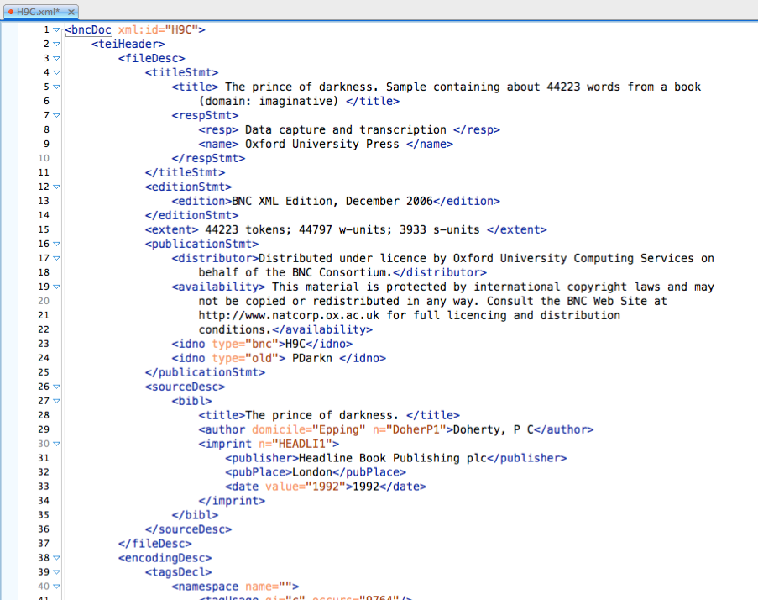
XML als Repräsentationsformat
TEI-Header enthält Metadaten
Beispiel aus dem British National Corpus
Informationen über den Text
Notes:
Verweis auf die Übung

Slide 12
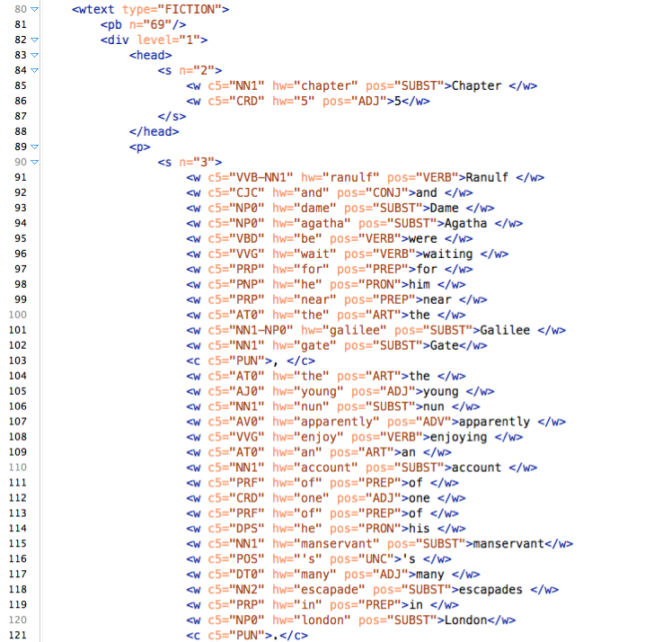
XML als Repräsentationsformat
TEI-Body enthält Objektdaten
Textstruktur & Darstellung
Token mit Annotationen
XML-Prinzip:
Durch Entfernen aller XML-Tags kann der ursprüngliche Objekttext wiederhergestellt werden

Slide 13
XML-Standards
XML (Extensible Markup Language) ist ein weitverbreiteter Standard für hierarchisch strukturierte Annotationen
ein wohlgeformtes XML-Document legt nur die Struktur der Annotation/Auszeichnung fest, nicht die Semantik (also was was bedeutet)
eine DTD (document type declaration) oder ein XML-Schema legt gültige Element- und Attributnamen fest
… erklärt aber ohne Dokumentation noch immer nicht die Semantik!
Austauschformate für Textkorpora: TEI (Text Encoding Initiative), XCES (Corpus Encoding Standard), ISO 24612: LAF (Linguistic Annotation Framework)
ideal für Archivierung und Interoperabilität
für Korpusabfragen u.a. wird aber effizientere Implementierung benötigt

Slide 14
CWB
IMS Open Corpus Workbench
ursprünglich 1993–1996 entwickelt (IMS Stuttgart)
Anwendungen: statistische Sprachverarbeitung, Lexikographie, Korpuslinguistik
Open-Source-Veröffentlichung 2005 (GPL)
Aktuelle Version: CWB 3.5 (UTF-8, Korpora bis zu 2 Milliarden Wörter)
Standardoberfläche: CQPweb
diverse simplere und/oder spezialisiertere Web-Oberflächen verfügbar
Kommandozeilen-CQP für erfahrene Benutzer (Uli Heid)
SketchEngine: gleiches Datenmodell, gleiche Abfragesyntax
aber unterschiedliche Implementierung
http://cwb.sf.net/

Slide 15
Vertical text format (.vrt) Einfacheres, effizienteres Format ➞ wird von CWB & NLP-Tools verwendet
<corpus>
<story title="The Garden">
<p>
<s>
It PP it
seemed VBD seem
a DT a
day NN day
much RB much
as IN as
any DT any
other JJ other
until IN until
I PP I
...
</s>
</p>
</story>
</corpus>
metadata
title: The Garden
author: Stefan Evert
author sex: male date: 05.08.1991
Tabulatorzeichen (\t, \x09)

Slide 16
Vertical text format (.vrt) Textmetadaten in den XML-Start-Tags (nicht im Header!)
<corpus>
<text title="The Garden" author="Stefan Evert" author_sex="male" date="1991-08-05">
<p num="1">
<s>
It PP it
seemed VBD seem
a DT a
day NN day
much RB much
as IN as
any DT any
other JJ other
until IN until
I PP I
...
</s>
</p>
</text>
</corpus>
CQPweb requires <text>, SketchEngine prefers <doc>
sub-text level metadata

Slide 17
CoNLL-Format(e) Vertical Text ohne Metadaten (weit verbreitet in NLP)
# story: "The Garden"
# paragraph #1
1 It PP it
2 seemed VBD seem
3 a DT a
4 fine JJ fine
5 day NN day
6 . SENT .
1 There EX there
2 was VBD be
3 an DT a
4 elephant NN elephant
5 . SENT .
# this is the end of the file
Metainformation in Kommentaren
Leerzeile = Satzgrenze
Token durchnummeriert (je Satz)

Slide 18
CWB: Datenmodell
# word pos lemma 0 A DET a
1 fine ADJ fine
2 example NN example
3 . PUN .
4 Very ADV very
5 fine ADJ fine
6 examples NN example
7 ! PUN !
implizite Nummerierung der Token: Korpusposition (cpos)

Slide 19
CWB: Datenmodell
# word pos lemma
(0) <text id="42" lang="English">
(0) <s> 0 A DET a
1 fine ADJ fine
2 example NN example
3 . PUN .
(3) </s>
(4) <s>
4 Very ADV very
5 fine ADJ fine
6 examples NN example
7 ! PUN !
(7) </s>
(7) </text>
XML-Tags als „unsichtbare“ Token

Slide 20
CWB: Datenmodell
p-Attribute
# word pos lemma
(0) <text id="42" lang="English">
(0) <s> 0 A DET a
1 fine ADJ fine
2 example NN example
3 . PUN .
(3) </s>
(4) <s>
4 Very ADV very
5 fine ADJ fine
6 examples NN example
7 ! PUN !
(7) </s>
(7) </text>
interne Dar-stellung als Tokenbereiche (cpos spans) der Form [start, end]
id="42" lang="English"
s-Attribute

Slide 21
Korpusabfragen mit CQP

Slide 22

Zum Ausprobieren: CQPweb & BNCweb
CQPweb (flexible Web-Oberfläche für CWB) https://corpora.linguistik.uni-erlangen.de/cqpweb/
Login: studentX (1 … 15)
Passwort: erlangen
Dokumentation: Tutorial-Videos auf YouTube https://www.youtube.com/user/CorpusWorkbench
BNCweb (speziell für British National Corpus) https://corpora.linguistik.uni-erlangen.de/bncweb/
gleicher Gäste-Login wie für CQPweb

Slide 23
Simple query syntax
viele Web-Oberflächen unterstützen eine „einfache“ Abfragesyntax
Wort oder Wortfolge einfach direkt eingeben
Platzhalter (wildcards) für variable/optionale Elemente (eingeschränkt)
hier: CEQL-Syntax (Common Elementary Query Language)
relativ mächtige einfache Abfragesprache
unterstützt von BNCweb, CQPweb und einigen anderen Web-Oberflächen
Tutorial & Dokumentation
Kap. 6 aus Hoffmann, Sebastian et al. (2008): Corpus Linguistics with BNCweb – a Practical Guide. Frankfurt a.M. [etc.]: Peter Lang.
CQPweb simple query manual
https://cqpweb.lancs.ac.uk/doc/cqpweb-simple-syntax-help.pdf

Slide 24
CEQL in a nutshell
speak exakt diese Wortform
{speak} alle flektierten Formen (Lemma)
at the end of the day exakt diese Wortfolge
is n't it \? Tokenisierungsregeln & Escapes
*able Suffix -able
+able ohne das Wort able selbst
light_JJ light als Adjektiv
Mr _N* männl. Person (Mr + Substantiv)
[Mr,Mrs,Ms] _N* Person (männlich oder weiblich)
Mr _N* {be} _J* Aussage über die Person (wird später noch verbessert)

Slide 25
CEQL in a nutshell
Smith:C Groß- und Kleinschr. beachten
deja:d vu:d Diakritika ignorieren
\D Zahl (mind. eine Ziffer)
\u\u\u\u:C Akronym (4 Großbuchstaben)
\u\L:C nur erster Buchstabe groß
take * off optionales Token
take ++*** off zwei bis fünf optionale Token
in ( _JJ* )? time optionales Adjektiv
Mr (_N*)+ {be} (_RB)? _J* + = 1 oder mehr
his ( _JJS | most _JJ )* _N* Alternativen
<s> but Satzanfang
<ne_type=PERSON> (+)+ </ne_type> XML-Element

Slide 26
CQP Query Syntax
formale Abfragenotation
basiert auf regulären Ausdrücken auf mehreren Ebenen
ermöglicht es, das Suchmuster sehr präzise festzulegen
deutlich flexibler und mächtiger als die CEQL-Syntax
von allen Web-Oberflächen unterstützt, die auf CWB basieren!
Tutorial & Dokumentation
Kap. 12 aus Hoffmann, Sebastian et al. (2008): Corpus Linguistics with BNCweb – a Practical Guide. Frankfurt a.M. [etc.]: Peter Lang. (= English Corpus Linguistics 6)
CQP Query Language Tutorial (online version)
http://cwb.sourceforge.net/files/CQP_Tutorial.pdf
http://cwb.sourceforge.net/files/CWB_Encoding_Tutorial/

Slide 27
CQP-Abfragen: einzelne Tokens
reg. Ausdruck in Anführungszeichen „matcht“ Oberflächenform von Tokens
"(over|under)\w+" / '(over|under)\w+'
um Anführungszeichen zu finden: """" / '"'
immer regulärer Ausdruck ➞ Escapes bei Metazeichen nicht vergessen
Suchoptionen:
"deja"%c … case-insensitive (Groß- und Kleinschreibung ignorieren)
"deja"%d … diacritic-insensitive (Diakritika ignorieren)
"deja"%cd … beides
"?"%l … exakte Zeichenkette (keine Metazeichen)
Beispiele hier in BNCweb mit dem CLAWS C5-Tagset

Slide 28
CQP-Abfragen: einzelne Tokens
Abfage von Token-Annotation mit einem Attribut-Wert-Paar aus p-Attribut und regulärem Ausdruck für den Wert des Attributs:
[lemma = "(over|under)\w+_ADJ"] (im BNC)
[pos = "AJS"] … Superlative (BNC)
"deja"%cd ist Kurzform für [word = "deja"%cd]
Bedingungen mit Booleschen Operatoren kombinieren:
Operatoren: & (und), | (oder), ! (nicht), != (ungleich)
[(word="can"%c) & (pos!="VM.*")]
äquivalent zu [(word="can"%c) & !(pos="VM.*")]
token description

Slide 29
CQP-Abfragen: Token-Folgen
CQP-Abfragen sind reguläre Ausdrücke über token descriptions ([…])
"in" [pos="AJ.*"]? [hw="year"] … optional
"in" [pos="AJ.*"]+ [hw="year"] … mindestens eins
"in" [pos="AJ.*"]{2} [hw="year"] … genau zwei
([pos="AJS"] | "most"%c [pos="AJ0"]) … entweder oder
Abstände
[] … matchall (beliebiges Token)
"dog" []{0,4} "cat" … maximal vier Token dazwischen
"dog" []{0,4} "cat" within s … im selben Satz (s-Attribut)

Slide 30
CQP-Abfragen: s-Attribute
XML-Tags „matchen“ Start- und End-Tag von s-Attribut-Bereichen (regions)
<head> "UK" … als erstes Wort einer Überschrift
"UK" </head> … als letztes Wort einer Überschrift
<head> … findet nichts (weil Länge von 0 Token)
<mw> []* </mw> … passende Start-/End-Tags matchen ganzen Bereich
innerhalb eines Bereichs suchen:
"Twain" within quote;
[pos="NN.*"] :: match.mw_pos = "PRP"; … Abfrage von s-Attribut-Annotationen im „global constraint“ … so können auch Bedingungen an Metadaten in der Query gestellt werden
vordefinierte Anker: match, matchend, target (@)

Slide 31
CQP-Abfragen: Token-Folgen
Quantoren und Alternativen können verschachtelt werden, um komplexe lexikalisch-grammatische Muster zu finden:
([pos="AJS"] | "most"%c [pos="AJ0"])
( "(and|\,)"%c ([pos="AJS"] | "most"%c [pos="AJ0"])
)+
[pos = "NN.*"]
Voreinstellung: möglichst wenig Wiederholungen (non-greedy)
"ho"%c ("," "ho"%c)+ … findet immer ho, ho
(?longest) "ho"%c ("," "ho"%c)+ … Strategie auf greedy matching umstellen (in CQPweb auch über UI möglich)
Was tut diese Abfrage?

Slide 32
Überlegungen vor der Recherche (1)
Vor einer ernsthaften Korpusrecherche gilt es, einige wichtige Überlegungen anzustellen:
Was ist die sprachliche Grundgesamtheit, die einen interessiert? Standarddeutsch? (In Deutschland? In der Schweiz? Geschrieben und/oder gesprochen?) Eine bestimmte Varietät? Eine bestimmte Textsorte? Texte mit einem bestimmten Themenbezug? Texte aus den letzten paar Jahren oder aus vergangenen Jahrhunderten?
Gibt es ein Korpus oder Teilkorpus, das dafür geeignet ist?
Ist das gewählte Korpus groß genug? Ist daher für das zu untersuchende Phänomen mit genügend Treffern zu rechnen, um eine differenzierte Auswertung zu ermöglichen?

Slide 33
Überlegungen vor der Recherche (2)
Wie ist das Korpus genau aufgebaut? Welche Texte welcher Autoren, Textsorten, Entstehungszeiten usw. enthält es?
Welche Zweifel an der Repräsentativität des Korpus gibt es? Wie gravierend sind diese? Worauf ist bei der Auswertung zu achten?
Wenn sich kein passendes Korpus finden lässt oder erste Testabfragen keine oder nicht genügend Treffer liefern, muss man u.U. darüber nachdenken, ein eigenes Korpus zusammenzustellen (oder die Fragestellung ganz anders anzugehen – z.B. mit einer Befragung).

Slide 34
Übersicht: Web-Interfaces für Korpusabfragen

Slide 35
CQPweb
https://corpora.linguistik.uni-erlangen.de/cqpweb/
Login: studentX (1 … 15)
Passwort: erlangen
Hintergrund:
Hardie (2012); Evert & Hardie (2011)
http://cwb.sourceforge.net/
Dokumentation: Tutorial-Videos auf YouTube https://www.youtube.com/user/CorpusWorkbench
CEQL*
*http://cwb.sourceforge.net/ceql.php

Slide 36
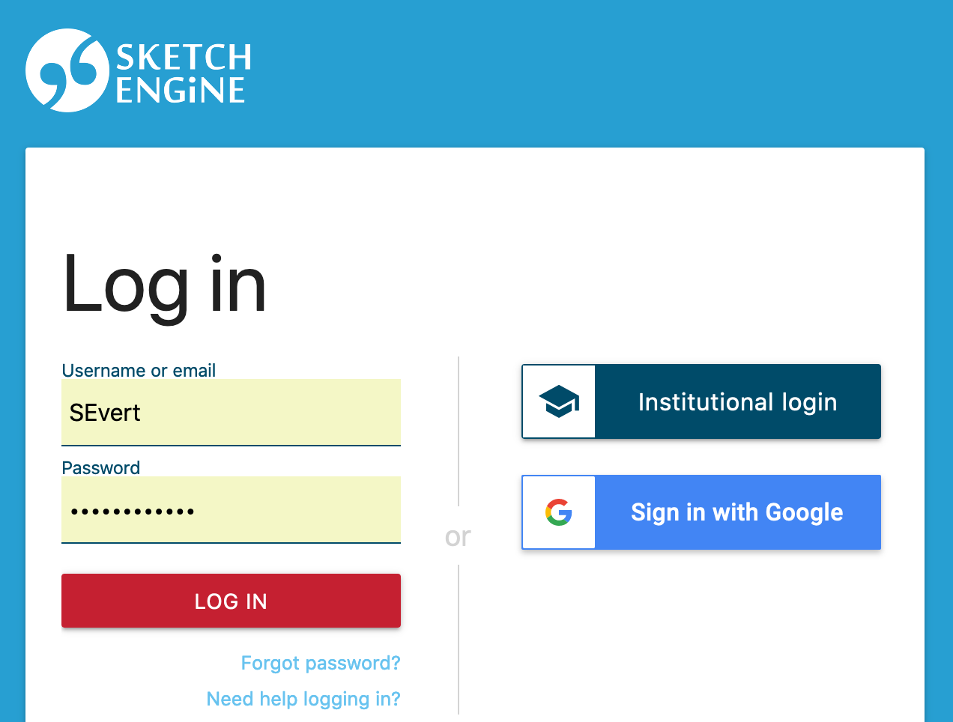
Sketch Engine
https://app.sketchengine.eu/
sehr große Auswahl von Korpora in vielen verschiedenen Sprachen verfügbar
kommerzieller Anbieter: €90 / Jahr und Person (für Forschungszwecke)
Erstellen/Hochladen eigener Korpora bis zu einer Größe von 1 Mio. Wörter möglich (Upgrades möglich: z.B. auf 50 Mio. Wörter für €300 / Jahr)
FAU hat leider keine Uni-Lizenz (€3000 / Jahr)
Bedienungsanleitung: https://www.sketchengine.eu/user-guide/

Slide 37
Andere Web-Oberflächen @ FAU
BNCweb (British National Corpus) https://corpora.linguistik.uni-erlangen.de/bncweb/
Login: studentX
Passwort: erlangen
v.a. auch für Beispiele und Übungsaufgaben aus Corpus Linguistics with BNCweb – a Practical Guide (Hoffmann et al. 2008)
Debatten aus dem Europäischen Parlament http://corpora.linguistik.uni-erlangen.de/demos/CQP/Europarl/
deutsche Zeitungen aus 1990er Jahren (HGC: Huge German Corpus) http://corpora.linguistik.uni-erlangen.de/demos/auth/HGC/
Login: demo
Passwort: demo
morphologisch annotiert
CEQL*
CEQL*
CEQL*
*http://cwb.sourceforge.net/ceql.php

Slide 38
Weitere Web-Oberflächen (CWB-basiert)
OPUS: Sammlung von Parallelkorpora
Leeds IntelliText (diverse Sprachen, Web-Korpora)
BFSU CQPweb (chinesische & englische Korpora @ BFSU)
Linguateca AC/DC (Portugiesisch)
Ungarisches Nationalkorpus
Corpus del Español Actual (Spanisch)
Varitext (Französisch)
Spraakbanken (Schwedisch)
KorpusDK (Dänisch)
http://opus.nlpl.eu/
http://corpus.leeds.ac.uk/itweb/htdocs/Query.html
http://111.200.194.212/cqp/
http://www.bfsu-corpus.org/channels/corpus
http://www.linguateca.pt/ACDC/
http://corpus.nytud.hu/mnsz/index_eng.html
http://spanishfn.org/tools/cea/english
http://syrah.uni-koeln.de/varitext
https://spraakbanken.gu.se/korp/
http://ordnet.dk/korpusdk/

Slide 39
Weitere Web-Oberflächen (CWB-basiert)
TSCorpus (Türkisch)
CORIS/CODIS (Italienisch)
SSLMIT La Repubblica (italienische Zeitungen)
BwanaNet (Katalanisch, Spanisch, Englisch)
Georgetown University CQPweb (diverse Korpora)
Perugia Corpus (Italienisch)
CorpusEye (diverse Sprachen)
TEI:TOK (mehrere Sprachen)
http://tscorpus.com/
http://corpora.ficlit.unibo.it/
http://dev.sslmit.unibo.it/corpora/corpus.php?path=&name=Repubblica
http://bwananet.iula.upf.edu/
https://corpling.uis.georgetown.edu/cqp/
https://www.unistrapg.it/cqpweb/
http://corp.hum.sdu.dk/
http://www.teitok.org/index.php?action=projects

Slide 40
Andere beliebte Web-Oberflächen
BYU Corpora (von Mark Davies)
COCA, COHA, Seifenopern, GloWbE, TIME, Spanisch, Portugiesisch, …
Google Web 1T 5-Grams (N-gramm-Datenbank)
N-Gramme durchsuchen, vorberechnete (Quasi-)Kollokationen
NetSpeak: hübschere Web-Oberfläche
Google Books Ngram Viewer (Info)
Visualisierung von Frequenzänderungen im Laufe der Zeit (Wörter, Phrasen)
Linguee: Englisch, Deutsch, Französisch
Web-crawled parallel corpora for many language pairs
nützlich, um mögliche Übersetzungen zu finden (caveat emptor …)
Treebank.info (automatisch syntaktisch annotierte Korpora)
http://www.english-corpora.org/
http://corpora.linguistik.uni-erlangen.de/cgi-bin/demos/Web1T5/Web1T5_freq.perl
http://www.netspeak.org/
https://books.google.com/ngrams/
https://books.google.com/ngrams/info
http://www.linguee.com/
http://www.linguee.de/
http://www.linguee.fr/
http://treebank.info/

Slide 41
Andere beliebte Web-Oberflächen
DWDS-Korpora *
Korpusabfragen, (diachrone) Kollokationsanalyse, Wortverlaufskurven
COSMAS II *
Korpora des Instituts für deutsche Sprache (IDS), inkl. Kollokationsanalyse
DGD: Datenbank für gesprochenes Deutsch des IDS *
KorAP: neue Web-Oberfläche für IDS-Korpora (CQL-Abfragen möglich)
ANNIS-Interface der HU Berlin: diverse, v.a. kleinere Korpora
https://www.dwds.de/r | http://kaskade.dwds.de/dstar/
https://cosmas2.ids-mannheim.de/cosmas2-web/
https://dgd.ids-mannheim.de
https://korap.ids-mannheim.de/
https://korpling.german.hu-berlin.de/annis3/
* Kurzanleitung für DWDS, COSMAS II und DGD: http://sprachwissenschaft.fau.de/personen/daten/blombach/korpora.pdf

